Slide 1
DESIGN AND ANALYSIS OF HYBRID CRYPTOGRAPHY SYSTEM FOR SECURE COMMUNICATION
TEAM MEMBERS:
K.VAMSI MOHAN REDDY(19091A05H3)
A.SAI THANU SREE(19091A05C7)
L.VASAVI(19091A05H4)
Under the guidance of
Dr. N. MADHUSUDHANA REDDY M.Tech , Ph.D.
PROFESSOR
COMPUTER SCIENCE AND ENGINEERING

Slide 2
BIRDS VIEW
Abstract
Introduction
Functionalities
Scope
Literature Review
Problem Definition
Vigenere Cipher
Polybius Cipher
Proposed Methodology
System Architecture
Requirements
UML Diagrams
Results
Conclusion
References

Slide 3
ABSTRACT
Information Security is basically the practice of preventing unauthorized access, use, disclosure, disruption, modification, inspection, recording or destruction of information.
The Cryptography is the study of secure communication techniques which implies the craft of ensuring data by changing it into an unreadable format.
The dynamite growth of the Internet has made an expanded familiarity with uncertainty issues, Even though security is the major constraint over the internet, numerous applications have been created and structured without considering fundamental destinations of data security.
In this project a combination of Vigenere cipher and Polybius cipher is used for designing a hybrid cryptography system.
Our proposed work deals with advancement of Polybius cipher in existing strategy and performing hybrid cryptography using vigenere cipher and advanced Polybius cipher.

Slide 4
INTRODUCTION
Security is a significant factor in the open system and cryptography assumes a significant job in this field.
The goal of cryptography is utilized not exclusively to give classification, yet in addition to giving arrangements to different issues: data trustworthiness, verification, non-denial.
To forestall some undesirable clients or individuals to gain admittance to the data and to achieve confidentiality, authentication and protection cryptography is required
Compared to standard approach of using single cipher, this ideology provides better ways to secure data. This process will wind up making the last ciphertext progressively hard to be broken.

Slide 5
FUNCTIONALITIES
Data security is one of the most vital variables that need consideration during the process of data transfer, this vitality gave rise to cryptography.
This new paradigm experienced various developments in recent years. But due to its inception it has advancements to develop.
Hybrid cryptography is a combination of light weight ciphers, so it provides high security as compared to other techniques and Transmission of data becomes secure.
In this paper we tried to infer about a hybrid cryptographic system using Vigenere cipher and Polybius cipher.

Slide 6
SCOPE
Cryptography is a term defined as encapsulating and contriving techniques which permit important information and data to be sent in a protected structure so that the main individual ready to recover this information is the conscious beneficiary.
Today, brute force, or attempting random keys until the correct one is identified, is the most popular attacking encryption procedure.
Usage of single encryption algorithm can be proned to attacks, a hybrid encryption scheme is used to provide enhanced security.
A Hybrid Cryptography system is designed to overcome the drawbacks faced in literature.

Slide 7
LITERATURE REVIEW
S.No | Paper Details | Method | Drawback
1. | F. M. S. Ali and F. H. Sarhan, “Enhancing security of vigenere cipher ` by stream cipher,” International Journal of Computer Applications, vol. 100, no. 1, pp. 1–4, 2014 | Vigenere cipher enhanced with stream cipher | High time complexity(due to binary calculations)
2. | Mendrofa, Elwinus & Purba, Elwin & Siahaan, Boy & Sembiring, Rahmat Widia. (2017). Collaborative Encryption Algorithm Between Vigenere Cipher, Rotation of Matrix (ROM), and One Time Pad (OTP) Algoritma. Advances in Science, Technology and Engineering Systems Journal. 2. 13-21. 10.25046/aj020503. | This method includes combinations of 3 algorithms namely vigenere, One Time Pad,Rotation of Matrix. | The encryption mechanism used is still modest or simple. Encryption and decryption process have to done through a long route, it increases time complexity of the method.

Slide 8
LITERATURE REVIEW
S.No | Paper Details | Method | Drawback
3. | M. Maity, “A modified version of polybius cipher using magic square and western music notes,” International Journal For Technological Research In Engineering, ISSN, pp. 2347– 4718, 2014 | In this method a unique 6x6 magic square and heptatonic increasing C major scale C– D–E–F–G–A– B is used for encryption. | For every substitution, each single character would have different types of codes, the order of alphanumeric characters are very difficult to guess
4. | C. Bhardwaj, “Modification of vigenere cipher by random numbers, ` punctuations & mathematical symbols,” Journal of Computer Engineering (IOSRJCE) ISSN, pp. 2278–0661, 2012. | Vigenere cipher with key of any type of characters(symbols, digits,alphabets) | High computation

Slide 9
LITERATURE REVIEW
S.No | Paper Details | Method | Drawback
5. | Arroyo, Jan Carlo & Delima, Allemar Jhone. (2020). A Modified Polybius Cipher with a New Element-in-Grid Sequencer. 9. 3249-3255. 10.30534/ijatcse/2020/119932020. | This method modifies the 5x5 Polybius square by dynamically shifting the elements determined through the keys’ ASCII code. | generates a new matrix for every character to be encrypted which in turn increases time complexity

Slide 10
PROBLEM DEFINITION
In the existing system, the combination of Vigenere cipher and Polybius cipher is used for designing a hybrid cryptography system.
The Polybius square has an identified drawback in the existing strategy.
The Polybius square does not have a key for data encryption and decryption process making it vulnerable for cracks.
The proposed work deals with advancement of Polybius cipher in existing strategy.

Slide 11
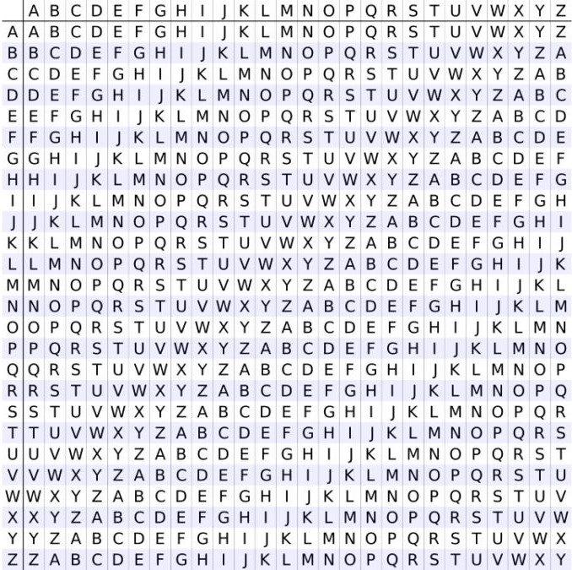
VIGENERE CIPHER
Vigenere Cipher is a method of encrypting alphabetic text. It uses a form of polyalphabetic substitution.
The encryption of the original text is done using the Vigenère square or Vigenère table.
The table consists of the alphabets written out 26 times in different rows, each alphabet shifted cyclically to the left compared to the previous alphabet, corresponding to the 26 possible Caesar Ciphers.
At different points in the encryption process, the cipher uses a different alphabet from one of the rows. The alphabet used at each point depends on a repeating keyword.

Slide 12
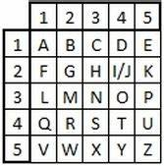
POLYBIUS CIPHER
The Polybius Cipher is a substitution cipher that is named after the Greek historian Polybius, who first described it.
The cipher works by assigning each letter of the alphabet a pair of coordinates on a 5x5 grid, where the letters are arranged in a square. The first four rows and columns of the square are filled with the letters A to Z, and the fifth row and column are filled with the numbers 1 to 5.
To encode a message using the Polybius Cipher, each letter of the message is replaced with its corresponding pair of coordinates on the grid.
To decode a message that has been encoded using the Polybius Cipher, the pairs of coordinates are translated back into their corresponding letters using the same grid.

Slide 13
PROPOSED METHODOLOGY
The proposed system deals with advancement of Polybius cipher to overcome the drawback in the existing system.
This modification allows extensive coverage for encrypting messages with alteration of letters in the arrangement of Polybius square.
This strategy also introduces a keyword to variate the arrangement of characters in the matrix(Polybius square).
This improved encryption results in ciphertext that is hard to be cracked utilizing existing cryptanalysis processes.

Slide 14
SYSTEM ARCHITECTURE
start
message
key
Vigenere cipher
Polybius cipher
Encrypted message

Slide 15
REQUIREMENTS
Software Requirements:
Programming language : Python
Tool : PyCharm
Operating System : Windows 7 or above (using windows 11)
Hardware Requirements:
Hard Disk Drive : 256 GB(using 512 GB)
Processor : intel i3 or above(using core i5)
RAM : 4 gb(min)

Slide 16
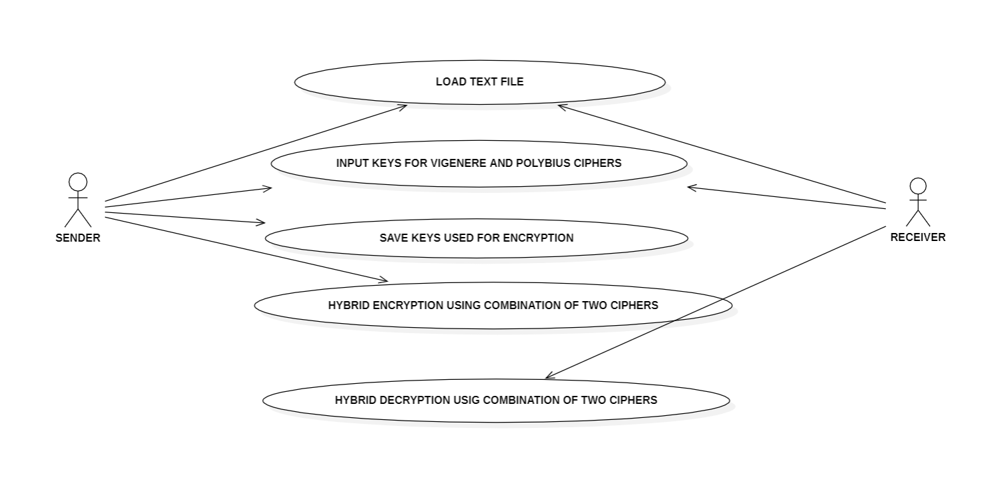
UML DIAGRAMS
USE CASE DIAGRAM

Slide 17
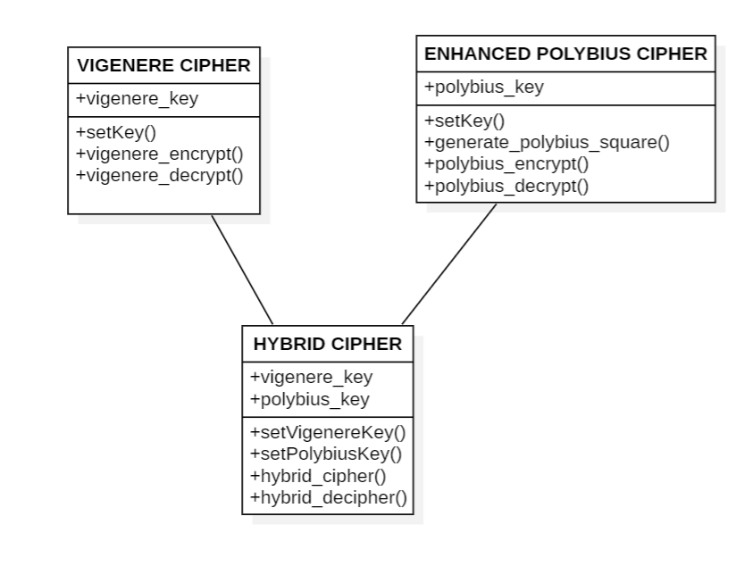
CLASS DIAGRAM

Slide 18
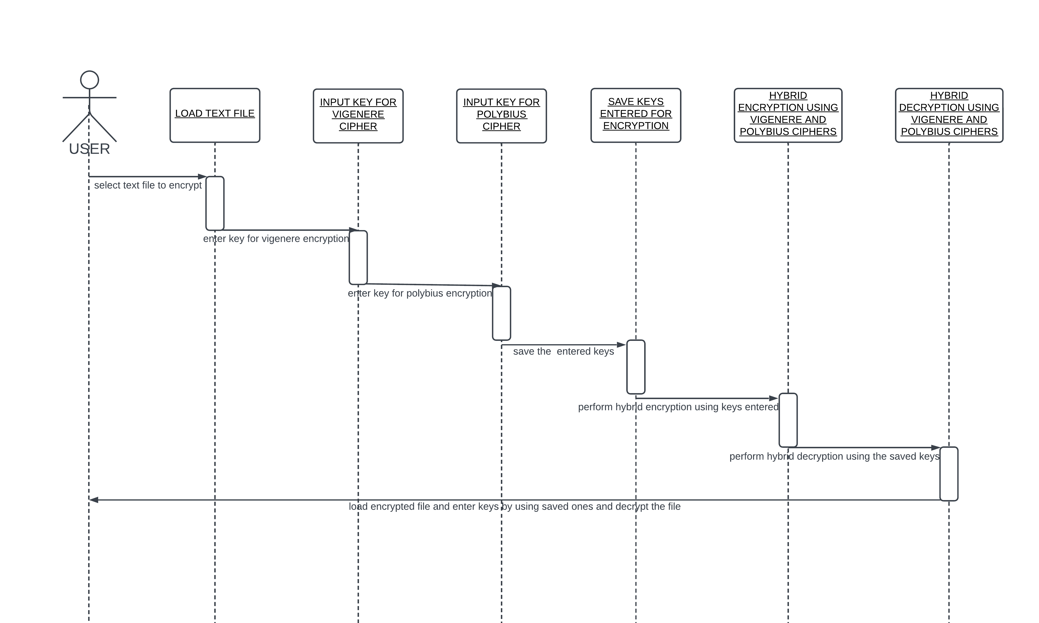
SEQUENCE DIAGRAM

Slide 19
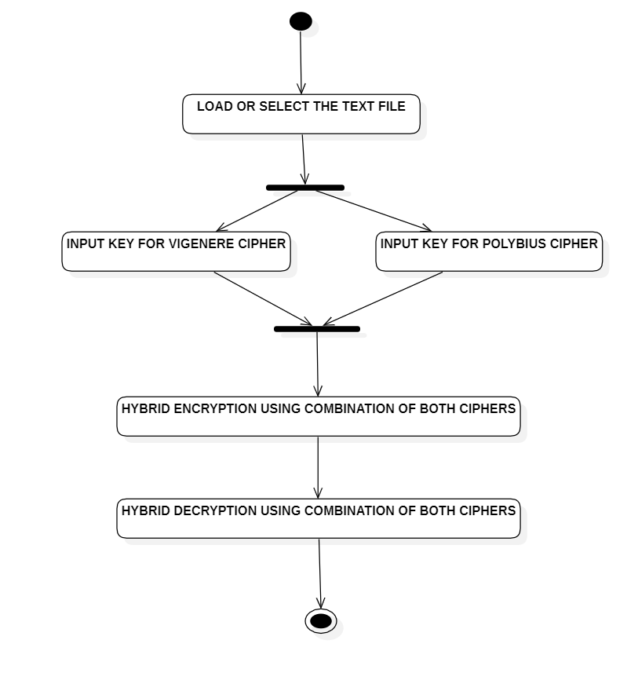
ACTIVITY DIAGRAM

Slide 20
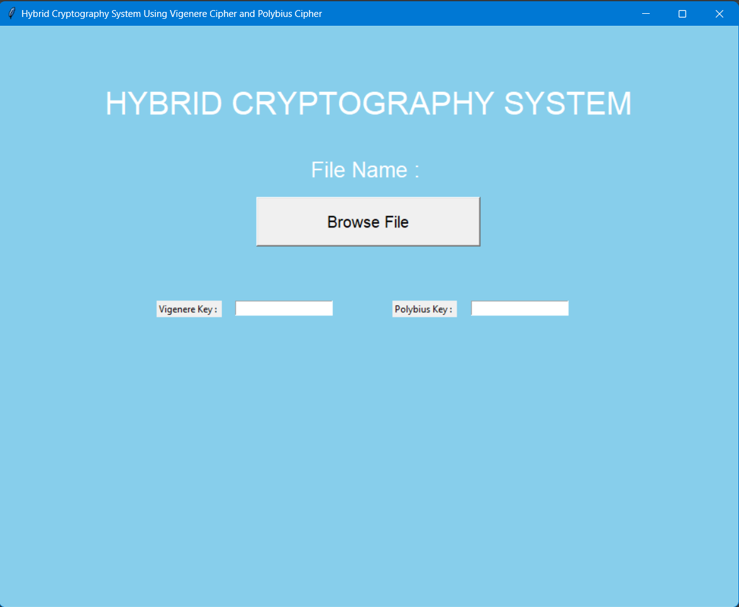
RESULTS

Slide 21
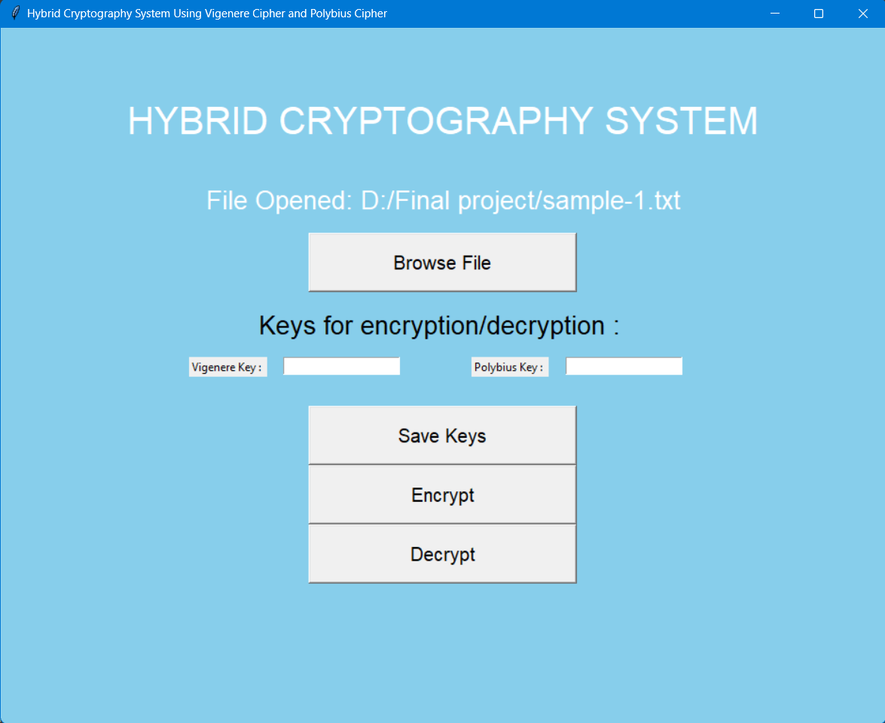

Slide 22
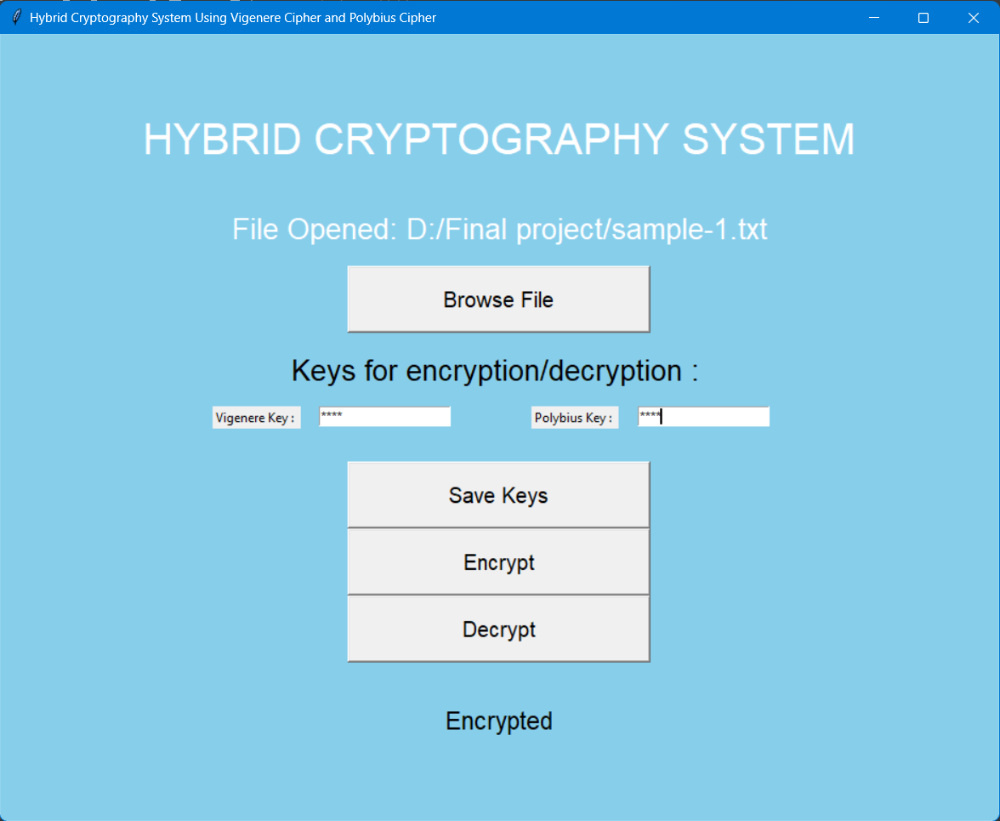

Slide 23
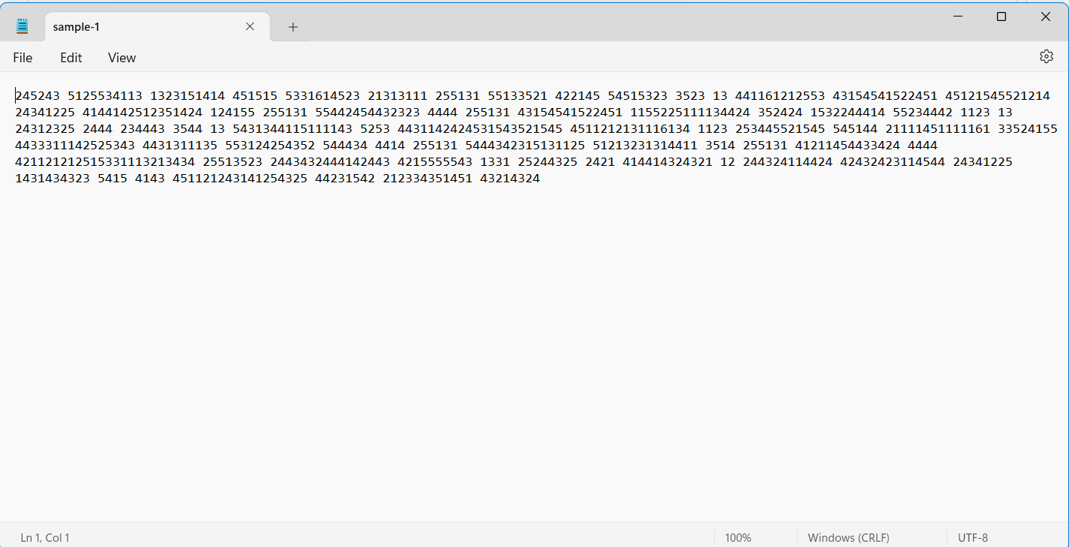

Slide 24
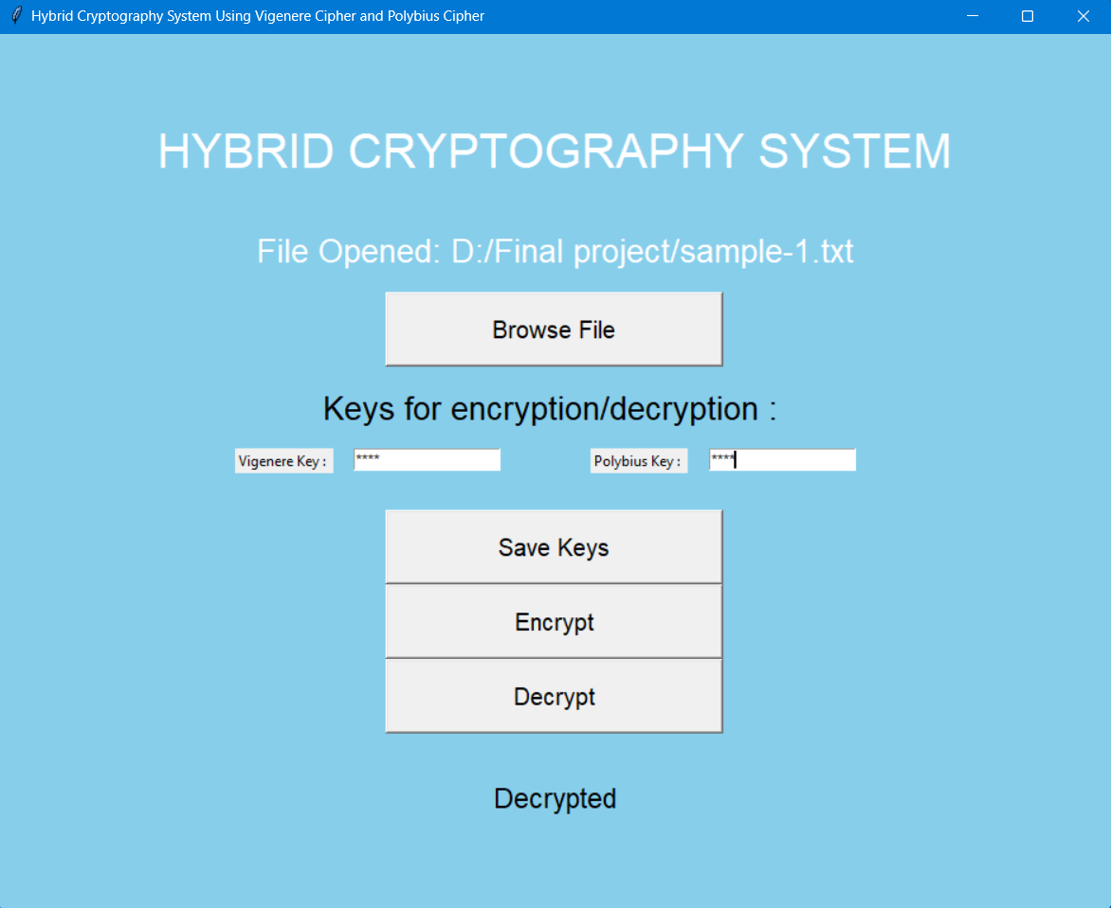

Slide 25
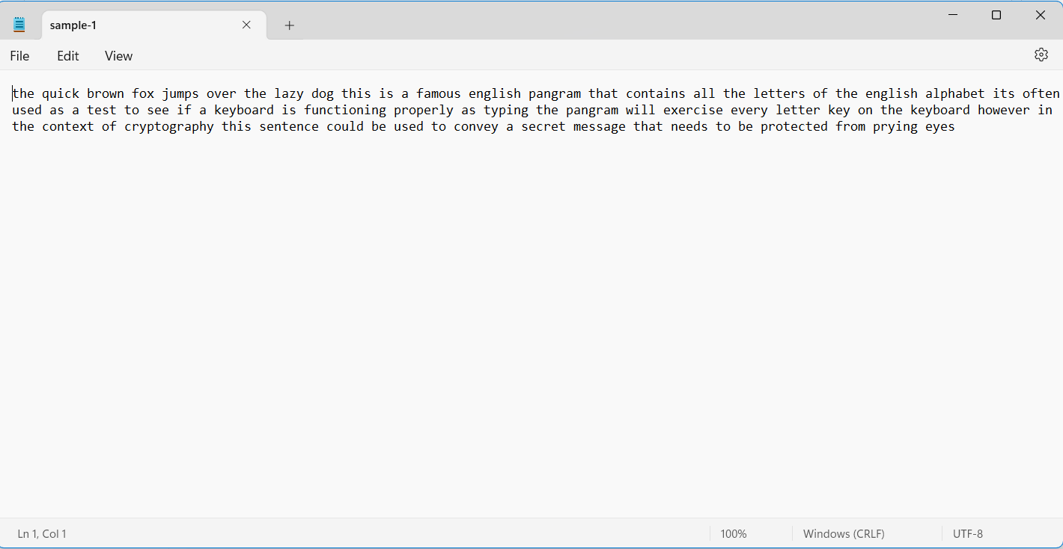

Slide 26
CONCLUSION
Cryptography is the widely used method for the security of data. The combination of Vigenere Cipher and Polybius Cipher is considered as secured method for polyalphabetic encryption.
To overcome the limitations of Polybius cipher we proposed a hybrid cipher with vigenere cipher and keyed Polybius cipher for enhanced security.
This proposed method provides better security from Kasiski and Friedman attacks. Cryptanalysis, frequency analysis, pattern prediction and brute attack on proposed technique are also much difficult due to use of Combination of two Ciphers for encryption.

Slide 27
REFERENCES
F. M. S. Ali and F. H. Sarhan, “Enhancing security of vigenere cipher ` by stream cipher,” International Journal of Computer Applications, vol. 100, no. 1, pp. 1–4, 2014.
Mendrofa, Elwinus & Purba, Elwin & Siahaan, Boy & Sembiring, Rahmat Widia. (2017). Collaborative Encryption Algorithm Between Vigenere Cipher, Rotation of Matrix (ROM), and One Time Pad (OTP) Algoritma. Advances in Science, Technology and Engineering Systems Journal. 2. 13-21. 10.25046/aj020503.
M. Maity, “A modified version of polybius cipher using magic square and western music notes,” International Journal For Technological Research In Engineering, ISSN, pp. 2347– 4718, 2014
C. Bhardwaj, “Modification of vigenere cipher by random numbers, ` punctuations & mathematical symbols,” Journal of Computer Engineering (IOSRJCE) ISSN, pp. 2278–0661, 2012.
Arroyo, Jan Carlo & Delima, Allemar Jhone. (2020). A Modified Polybius Cipher with a New Element-in-Grid Sequencer. 9. 3249-3255. 10.30534/ijatcse/2020/119932020.

Slide 28
THANK YOU

